Slide 1

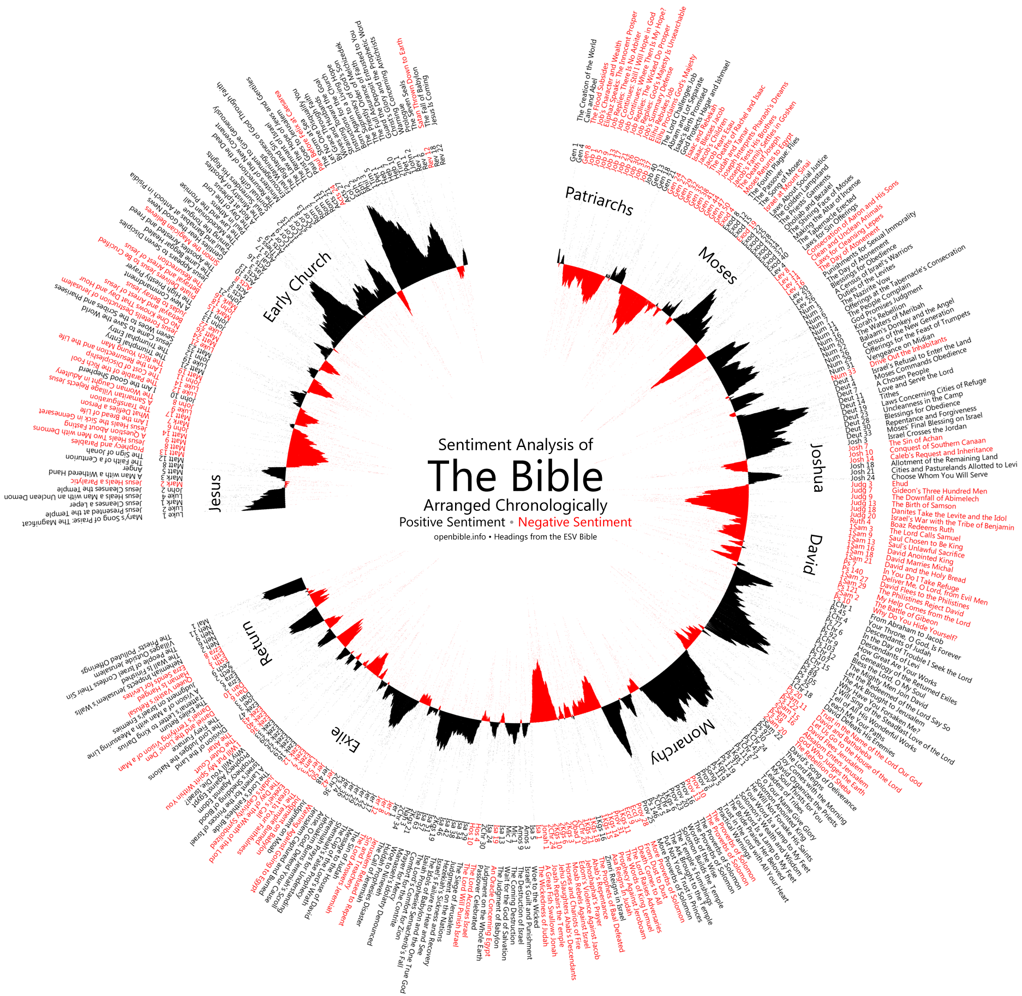

Text mining of social media feeds to perform sentiment analysis for technology release
Supervisor: Peter Carew
Lecturer in Computing,
Waterford Institute of Technology, Waterford, Co. Waterford
Ireland (Tel: 353-051-302628; e-mail: pcarew@wit.ie)
Author: Ali Akbar Jilani Student, Department of Science and Computing,
Waterford Institute of Technology, Waterford, Co. Waterford
Ireland (Tel: 353-085-212-6940; e-mail: 20078735@mail.wit.ie)

Slide 2


Agenda
1
Why Twitter - Importance
2
Objective & Research Questions
3
Preliminary Literature Review & Coverage
4
Working Hypothesis
5
Research Design
6
Research Plan

Slide 3













Why Twitter
#Windows
#iPhone7
#AdvertisingCampain
#TechnologyRelease
Social Media Icons Designed by Freepik

Slide 4



Importance
Academic Contribution
Volume of Twitter Sentiment Analysis performed in general using R
Little on Technology Release
Competitive Intelligence & Market Research
Voice of Customer – Source of feedback
Sentiment Analysis in R
R – Programming language (not typo) : (https://www.r-project.org/)
R – Powerful tool for statistical computing and graphics
TM – Text mining package in R

Slide 5



Objective and Research Questions
Is it possible to develop a tool or technology to predict success of technology release based upon sentiment analysis performed over pre-release historical social media data?
What would such a tool/ technology look like?

Slide 6









Preliminary Literature Review
Techniques and Applications for Sentiment Analysis (Ronen Feldman)
Sentiment Analysis - Document / Sentence level / Aspect based / Comparative
Architecture of a Generic Sentiment Analysis System
Corpus
Document
Processing
Document
Analysis
Sentiment
Scores
Linguistic
Resources
Lexicon

Slide 7












Supervised Classification Method for Sentiment Measurement
Pre-processing
Document Analysis
Sentiment Attachment
Visualization
Stemming
Document
Tokenization
Visual
Charts
Sentiment
Annotation
Sentence
Part of speech tagging
Entity Extraction
Aspects of entity
Statistical
Tools
Reports
Relation Extraction
Linguistic
Resources
Lexicon
Info-graphic
Other
Formats
Sentiment Analysis Steps
Corpus
Text Extraction
Pre-processing
Document
Analysis
Annotation
Attachment
Sentiment
Visualization

Slide 8
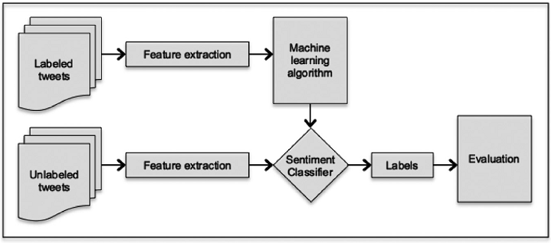
Preliminary Literature Review
Like It or Not: A Survey of Twitter Sentiment Analysis Methods (Anastasia et al)
TSA - Terminology, Challenges, Methods, Approaches, Data Collection.

Slide 9
Literature Coverage to date
Citations | 2009 | 2010 | 2011 | 2012 | 2013 | 2014 | 2015 | 2016 | 2017
CyberEmotions.eu
(Bermingham et al 2010)
Mozdeh (www.CREEN.org)
Carol et al
Ronen Feldman
Muhammad Saif et al
Paul Krill
Anastasia et al
Ribeiro et al
Lucan et al

Slide 10
Working Hypothesis
H1: The document sentiment of a tweet and its aggregate sentence level sentiment are equivalents/ correlated.
H2: There is a strong correlation between document (tweet) sentiment score calculated using one technique and the aggregate sentence-sentiment (score) calculated for the same tweet using at least one of the sentence level techniques.
H3: These two techniques (tweet level technique and sentence level technique) are not always the same for every set of tweets taken from the Twitter corpus.

Slide 11
Working Hypothesis
H4: The overall success of a technology release will be likely if the aggregate of these document level sentiment scores is positive and unlikely if their aggregate is negative (falls below zero).
H5: A dominant pattern is visible when all these sentiments are presented using a visualization tool.

Slide 12


Research Design
Tweet
(Technology Release)
Document Level Sentiment Analysis
Sentence Level Sentiment Analysis
Aspect Based Sentiment Analysis
Comparative
Sentiment Analysis
Sentiment Lexicon Acquisition
Support Vector
Machine SVM
Bootstrapping
Approach
W. Support Vector
Machine WSVM
XYZ
Approach
Linear Kernel
SVM
Minimum Cuts
Approach
Naïve Bayes
(NB)
Multi Naïve Bayes
(MNB)
FELDMAN, R. 2013. Techniques and applications for sentiment analysis. Communications of the ACM, 56, 82-89.
Supervised Classification method
for sentiment measurement

Slide 13
Supervised Classification Method for Sentiment Measurement
Pre-processing
Document Analysis
Sentiment Attachment
Visualization
Stemming
Document
Tokenization
Visual
Charts
Sentiment
Annotation
Sentence
Part of speech tagging
Entity Extraction
Aspects of entity
Statistical
Tools
Reports
Relation Extraction
Linguistic
Resources
Lexicon
Info-graphic
Other
Formats
Sentiment Analysis Steps
Corpus
Text Extraction
Pre-processing
Document
Analysis
Annotation
Attachment
Sentiment
Visualization

Slide 14
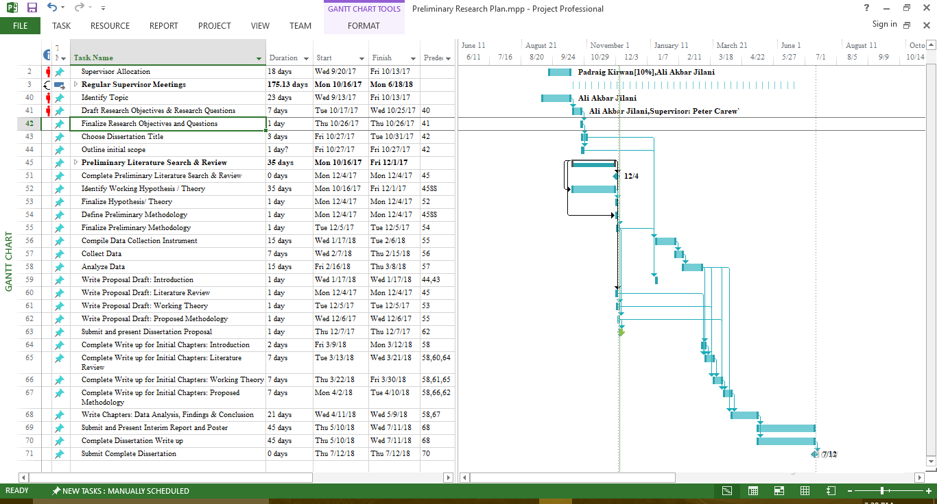
Project Planning

Slide 15
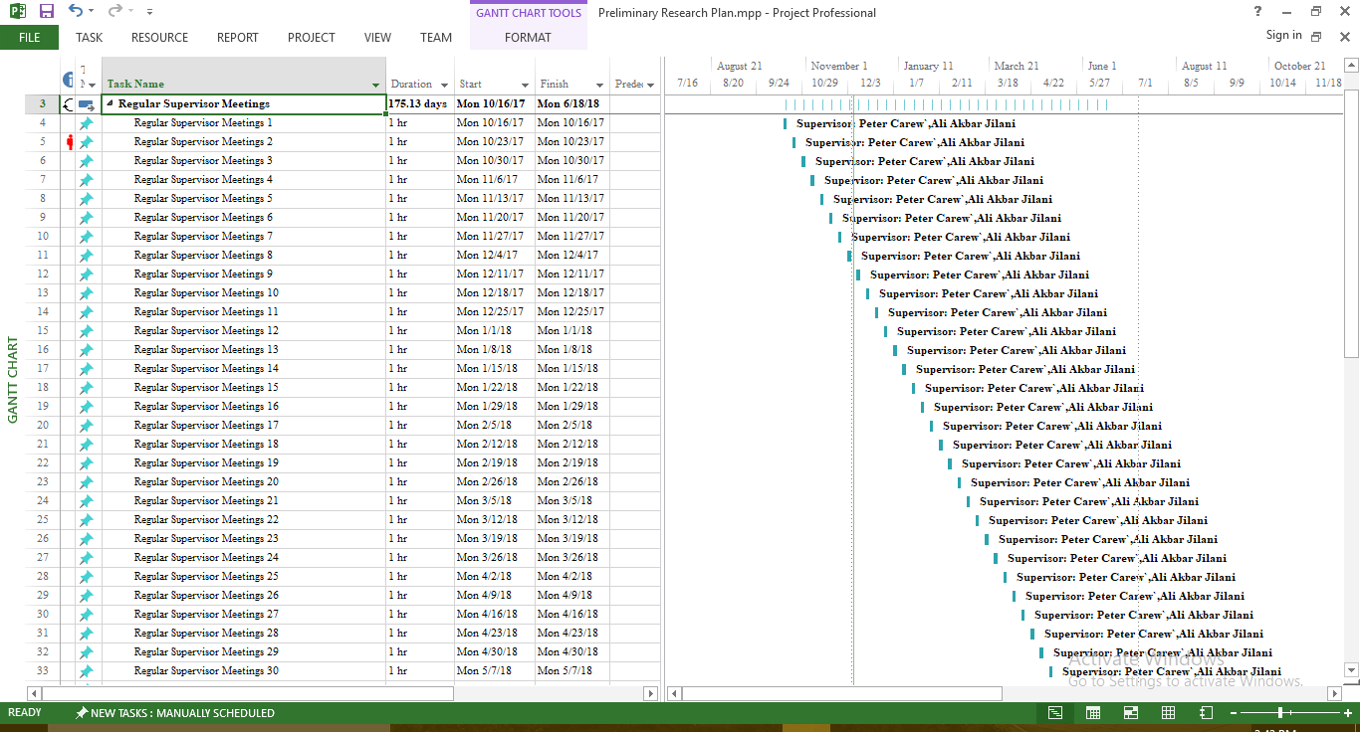
Supervisor Meetings Schedule

Slide 16
References
BERMINGHAM, A. & SMEATON, A. F. 2010. Classifying sentiment in microblogs: is brevity an advantage? Ireland, Europe: Association for Computing Machinery.
CAROL, T., RACHEL, V. & DONALD, W. K. 2013. Social media and scholarly reading. Online Information Review, 37, 193-216.
FELDMAN, R. 2013. Techniques and applications for sentiment analysis. Communications of the ACM, 56, 82-89.
GIACHANOU, A. & CRESTANI, F. 2016. Like It or Not: A Survey of Twitter Sentiment Analysis Methods. ACM Computing Surveys, 49, 28-28:41.
JEONG, B., YOON, J. & LEE, J.-M. 2017. Social media mining for product planning: A product opportunity mining approach based on topic modeling and sentiment analysis. International Journal of Information Management.
KRILL, P. 2015. Why R? The pros and cons of the R language [Online]. Available: https://www.infoworld.com/article/2940864/application-development/r-programming-language-statistical-data-analysis.html [Accessed 08/12/2017 2017].
PENG , E. A. May 13, 2014. Systems, methods and devices for generating an adjective sentiment dictionary for social media sentiment analysis: [US Patent & Trademark Office, Patent Full Text and Image Database]. United States, CA, Sunnyvale. patent application 13/082,963.
RIBEIRO, F. N., ARAÚJO, M., GONÇALVES, P., ANDRÉ GONÇALVES, M. & BENEVENUTO, F. 2016. SentiBench - a benchmark comparison of state-of-the-practice sentiment analysis methods. EPJ Data Science, 5, 23.
TRENDS, G. Google Trends - Sentiment Analysis [Online]. Available: https://trends.google.com/trends/explore?date=all&q=sentiment%20analysis [Accessed 19/11/2017].

Slide 17

End of Presentation
Thanks

